Slide 1

How Much Should You Be Paying For That HDB Flat?
Using linear regression to identify HDB attributes that influence resale price
DSIF-SG-9:
Mak Wei Yip
Tan Song Kai
Priscilla Li
Wen Yusheng

Slide 2

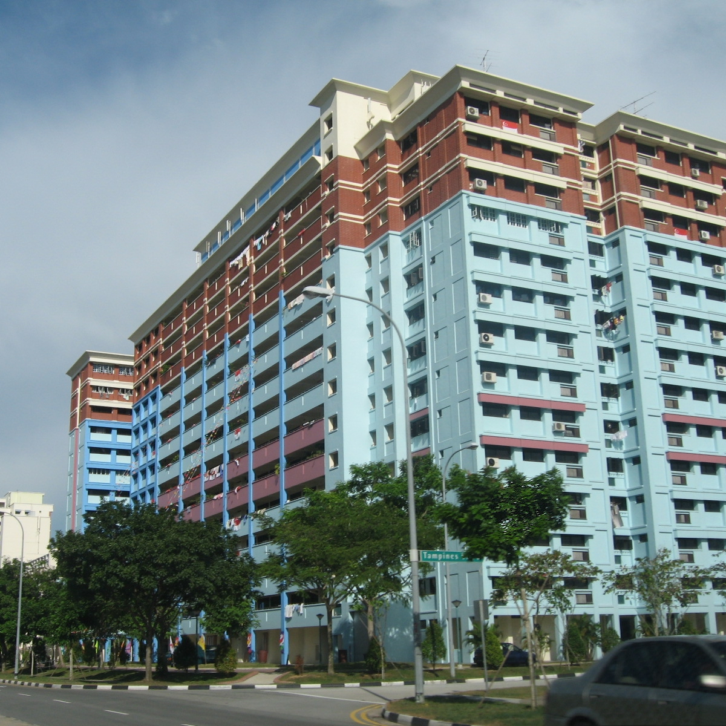
The Problem
Using historical resale HDB transaction data, can we more accurately predict HDB Resale Price for a potential buyer to determine the estimated market value of the HDB flat they are interested in?
Can this help a buyer to understand what factor play a larger part in influencing HDB Resale Price

Slide 3

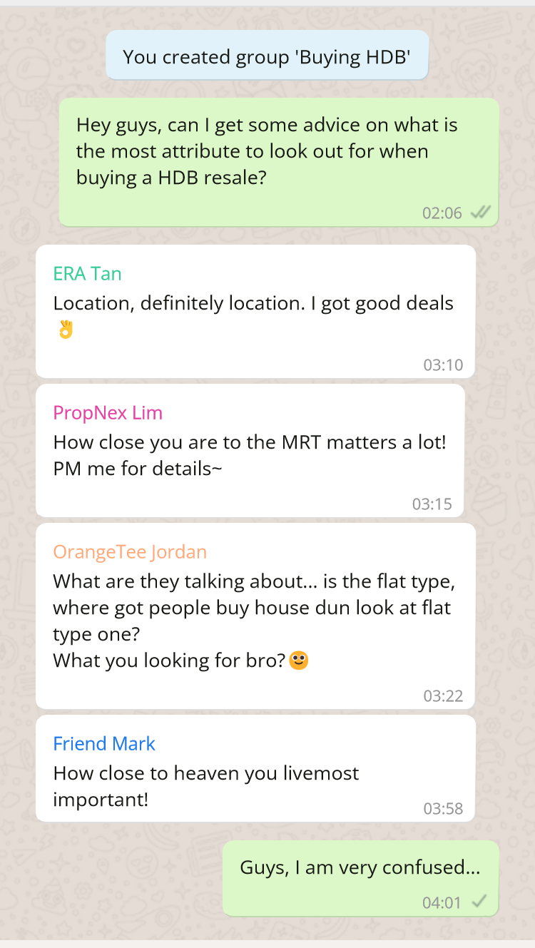
Different property agents, friends, websites all talk about various HDB attributes being important
Today, we will let the data speak for itself
Who should you believe?
How much does each actually matter?

Slide 4





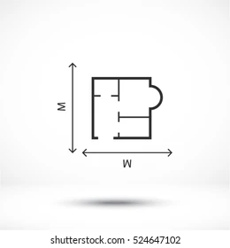
Taking a data-driven approach, these are the most important factors affecting the price you can expect to pay
Flat Model
Up to
$414k
Flat Type
Up to
$73k
Flat Location
Up to
$84k
HDB Height
Up to
$63k
Floor Level
Up to
$75k
Floor Area
ea 100sqft
$32k
Note: Based on historical HDB resale data from Mar 2012 to Apr 2021

Slide 5
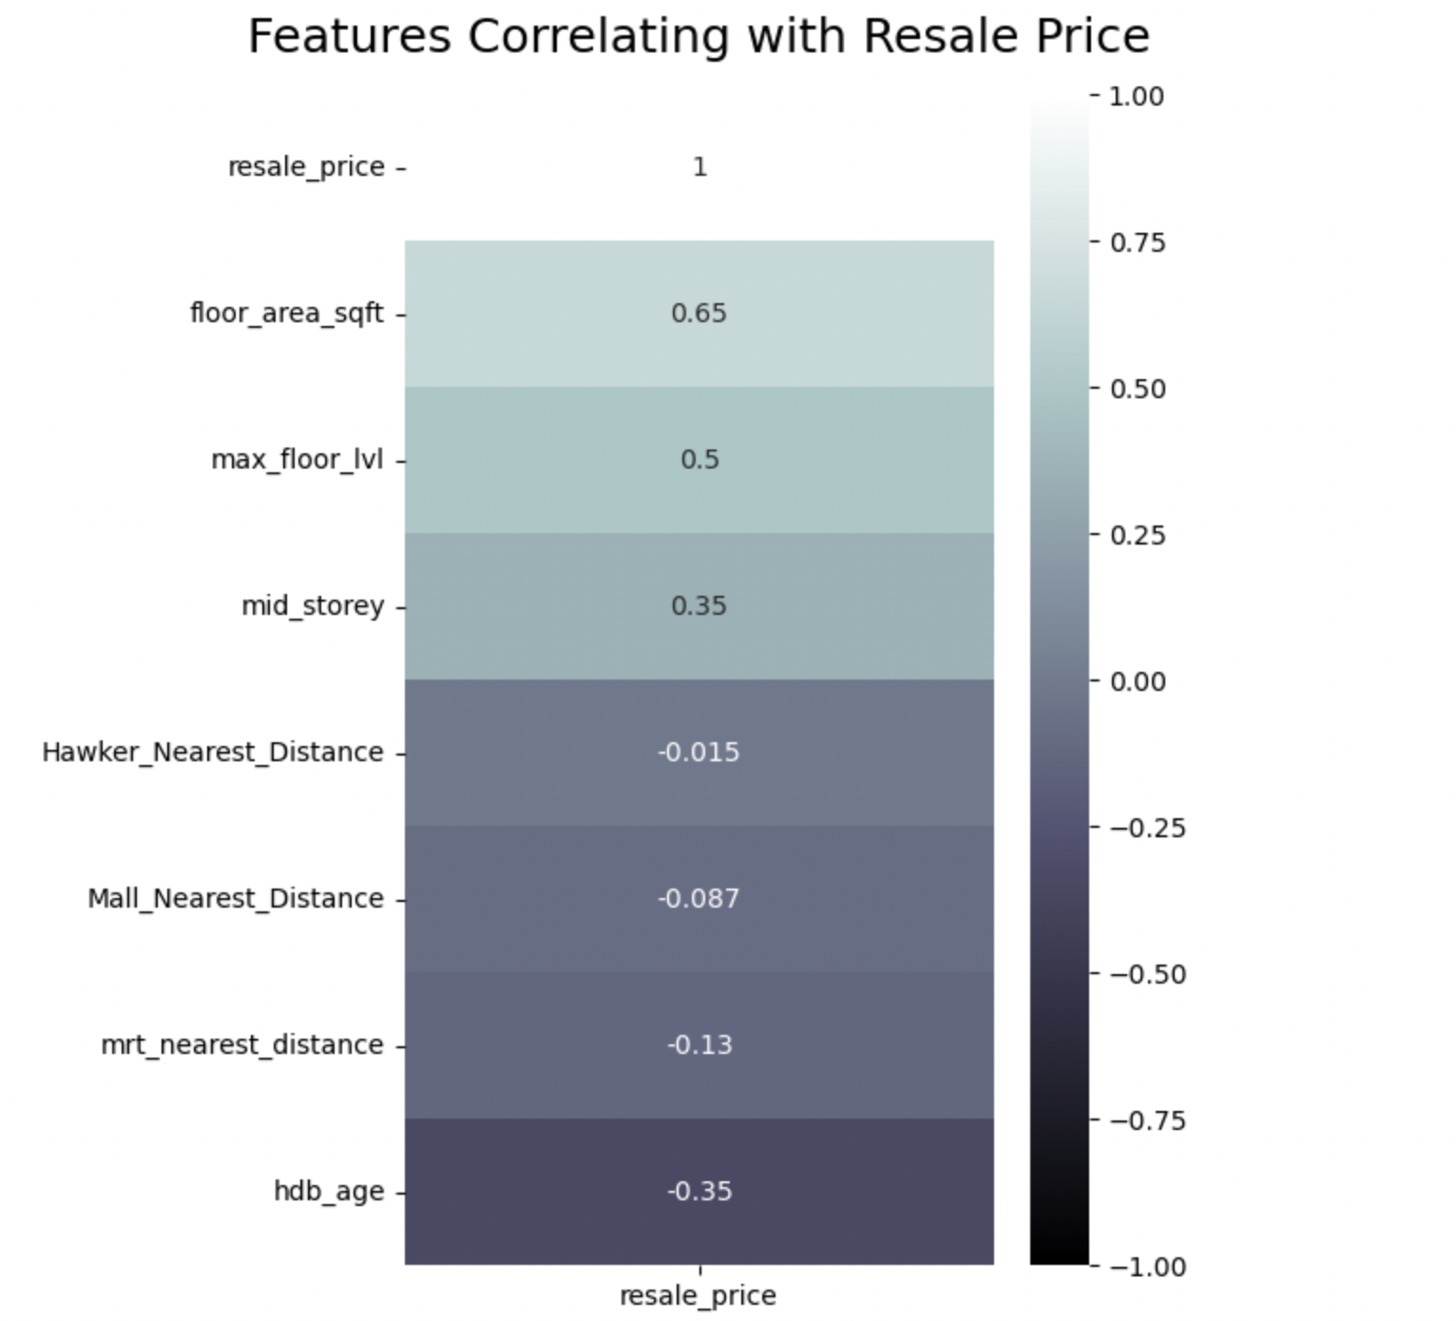
From historical HDB resale price data, these variables have the highest correlation with price
Resale Price
Floor Area (sqft)
HDB Block Height
Floor Level
Distance to Hawker Centre
Distance to Mall
Distance to MRT
HDB Age
Variable | Options <YS: adding in these options where we want to explain up front why we choose one variable and not another that is similar> | Correlation Strength
Floor Area (sqft) |  | 0.65
Number of Storeys |  | 0.5
Level of HDB | <YS: dun think need to tell layman audience about low, mid, high or mid_storey, since these are technicalities> | 0.35
Age of HDB | Hdb age | 0.35
Similar Units Sold | <YS: i actually not sure about this 3room_sold and 5room_sold i.e. how to explain one is 0.36 and the other is -0.41, suggest not to include>
Placeholder: Need a small text box to explain how to read correlatio n strength, e.g. if 1.0 perfect correlation and that means if we know the predictor, we can know the resale price
Notes:
Some text

Slide 6
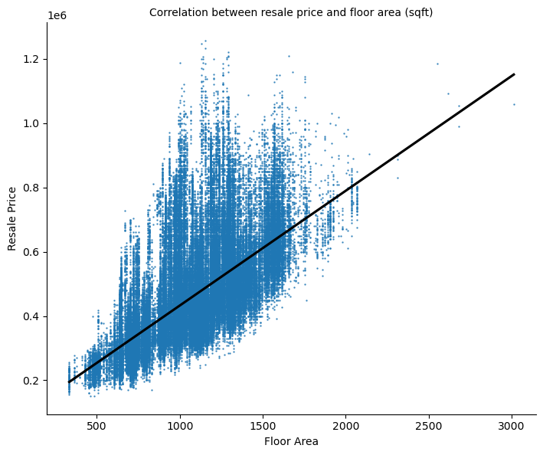
Floor area definitely plays a role in determining resale price
Notes:
Houses with larger areas tend to fetch higher prices
Everyone would love to have a larger house. Why not?
Singapore faces land scarcity → HDB flats are smaller now due to increasing land constraints.
6 million population as of 2023 → can u imagine how our housing landscape will look like in the next 5-10 years?
Proportion of houses with larger floor area will generally decrease over time → drive up the resale prices

Slide 7
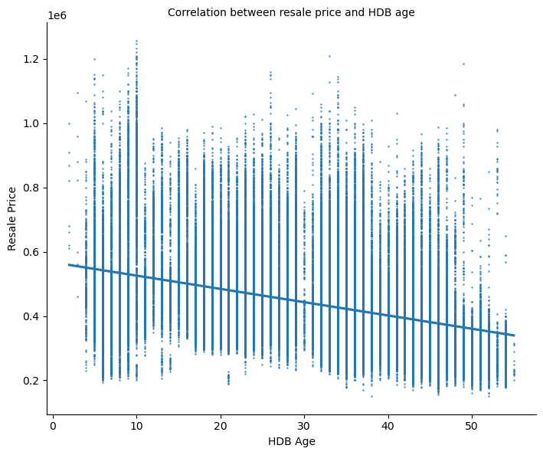
The older a unit, the cheaper it becomes?
Notes:
EDA less than 5 years: MOP waiver → divorce, demise, bankruptcy (financial hardship)
Older units → not just abt housing interior, exterior might be worse due to wear and tear over time
99 year lease period → HDB will surrender the land to the State
Newer units → 5-year MOP, CPF pay in full until 95 y/o → higher demand generally, with limited supply of flats → higher resale price
Personal example: lets say if i’m 30, would i prefer a flat with 20 years left, or 60 years left

Slide 8
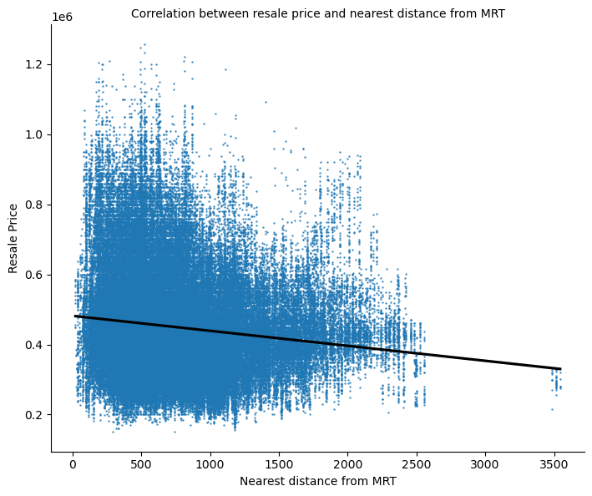
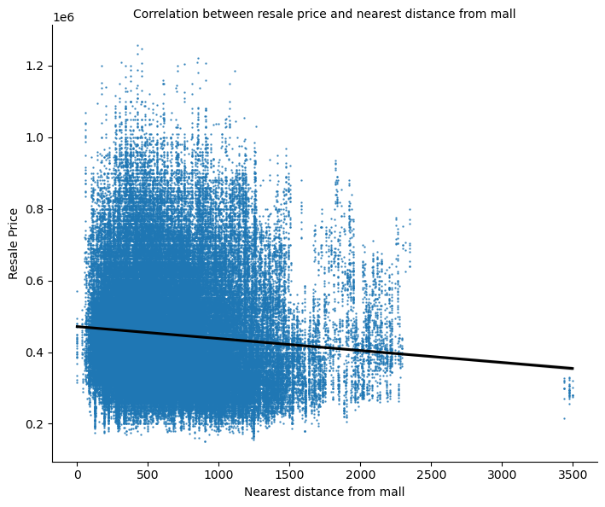
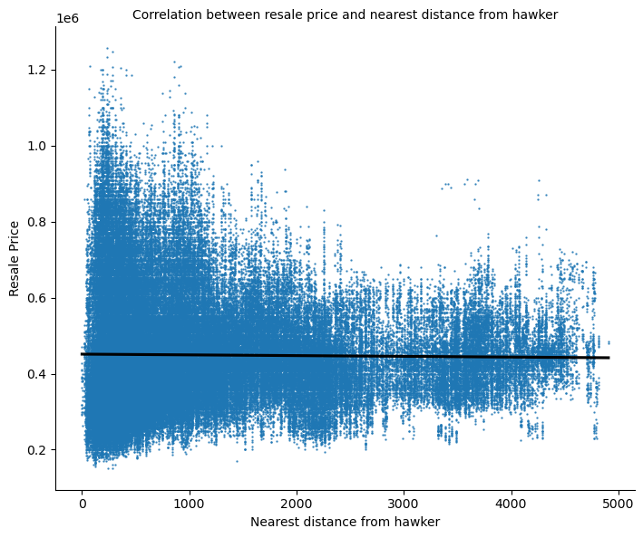
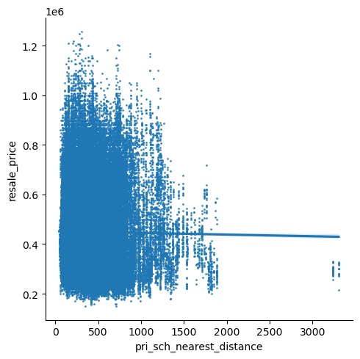
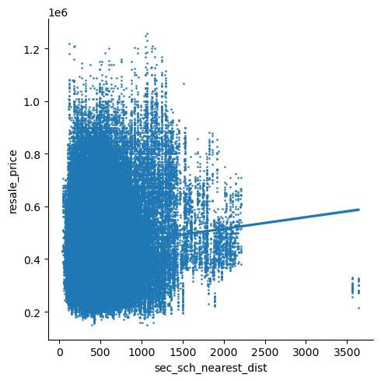
It’s not just only about our houses
MRT
Malls
Hawker Centres
Notes:
Scenario: would you want to spend 30 mins a day getting to the nearest MRT? Or a 5/10 min walk? Malls/hawker centres?
The small things add up, even though we experience inconvenience on a daily basis → this build up is seen in the vast difference in resale prices
Impression counts → “better houses” since nearer to diff facilities/amenities → connectivity
Hawker centres, we dont see such a clear difference in price → maybe because this is not a main consideration among Singaporeans as food preference is subjective, and people are willing to travel for their favourite food. However a decreasing trend is still expected as people still need to get their meals on a daily basis

Slide 9
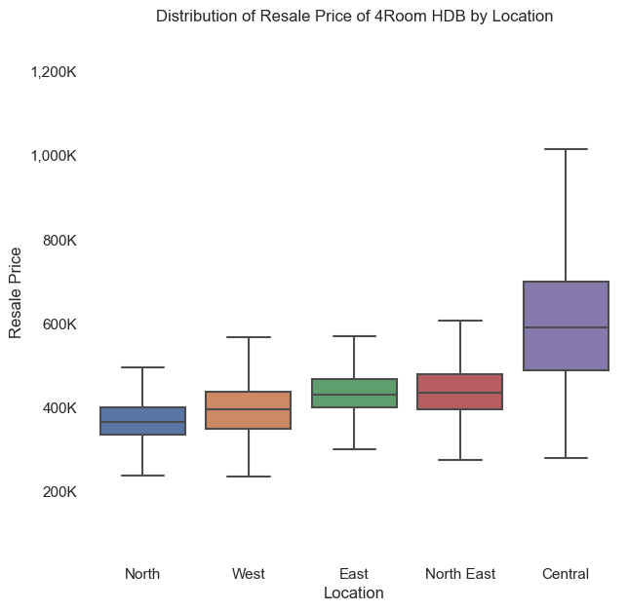
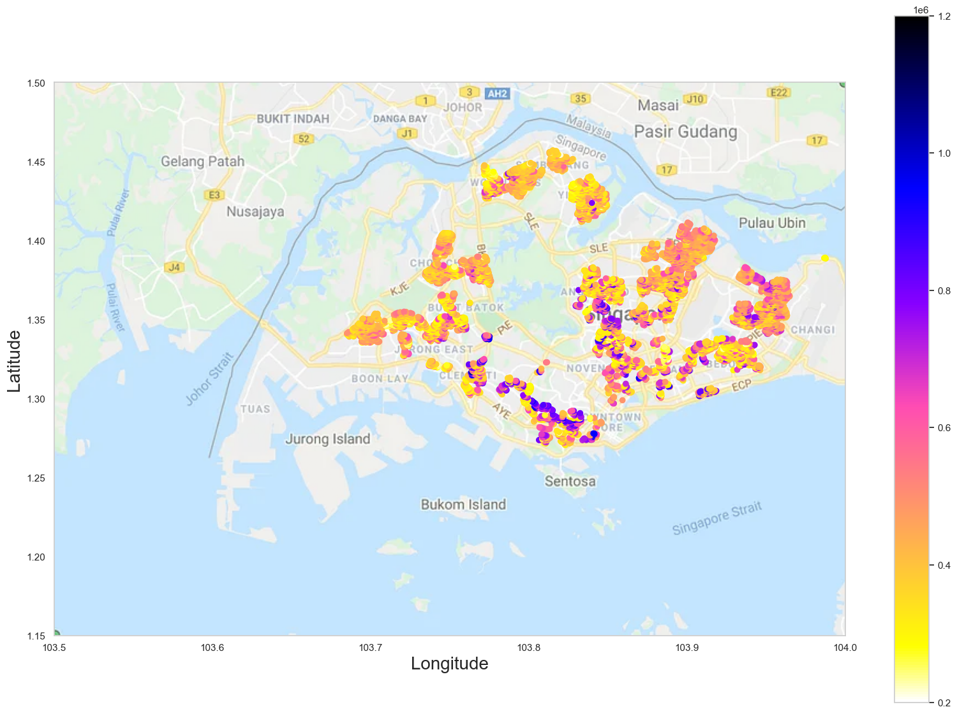
Location has an impact on resale price
590K
395K
430K
435K
367K
Notes:
3 categories
Heatmap, darker pricer, 5 distinct regions
Zoom into 4 room flat types. Central most ex at 590K
Dream of central region prepared to pay premium
Next we’ll see how location of hdb has an impact of its resale price. The heatmap on the left shows the median resale prices of all flats by location. The darker colours are where the more expensive flats can be found. Now let us look at the numbers, of which we’ll focus on a 4 room hdb flat as it was the largest groupset. On the extreme right we see that indeed, central region command a higher price at 590K, the east and north east the same at 450K, followed by the west, and the cheapest can be found in the north at 360K.
So if you have always dreamt of staying in a central location like pinnacle, do be prepared to pay a premium for it.

Slide 10
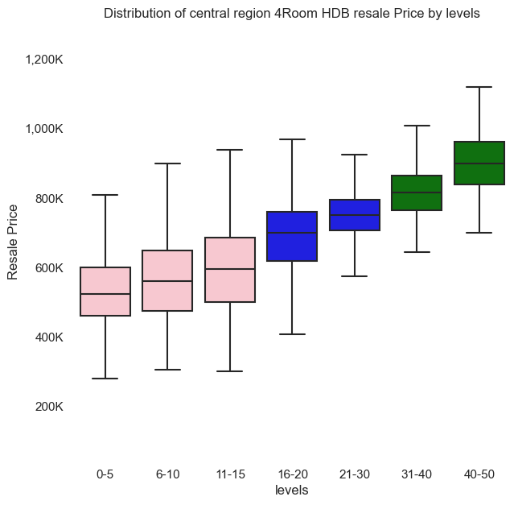
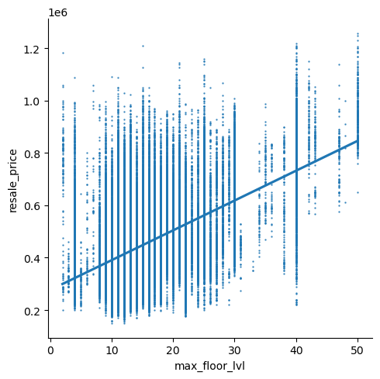
Higher floors command higher prices
900K
815K
700K
750K
560K
595K
523K
Notes:
Next feature
Same example of 4room central region
Max flat type, !caussation, possibility of integration with other feature
Next we look at the floor level and it’s impact on price. Continuing with the 4rm central region hdb flat example, 590K will be able to buy you a unit from 11-15 floors. As you go across to the right, the floor levels increase, as well as price up to a median price of 900K for those above 40-50 stories.
We would also like to share on observation that we found interest. Max floor levels seem be positively related to resale price, though this could be a interaction with higher floor levels.

Slide 11
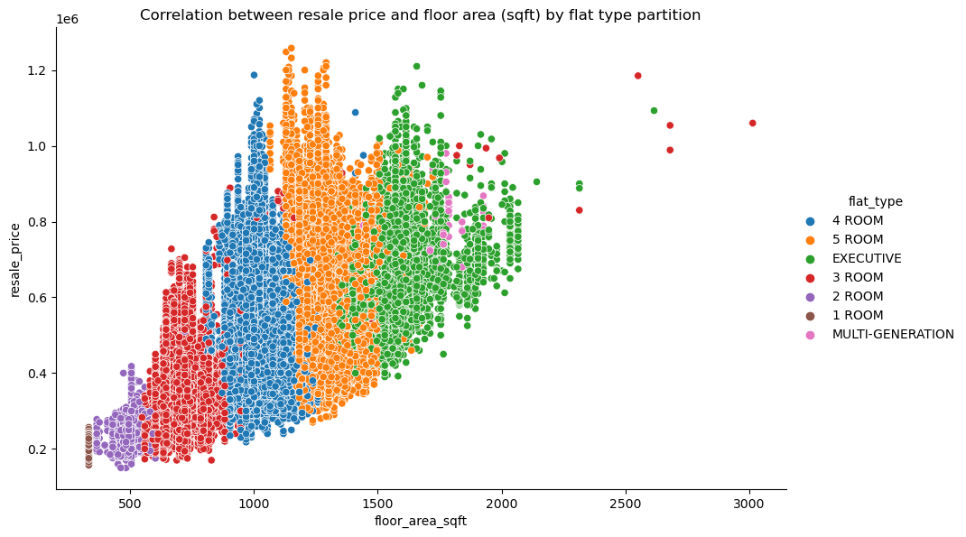
The type of flat also impact on resale price…
though not always the case
Notes:
3rd is flat type
Left to right distinct vertical bands, can expect larger floor area
Dots move up increase in price by flat type
Fan out of height of colored bars
Same example, same price can buy a 3 /5/exec
How so we make sense n address prob statement
Model will shed light
I’ll now look at a 3rd categorical feature that impacts price, and that’s flat type.
As we move across the X-axis from left to right, there are clear vertical colored bands which corresponds to the different flat types. And i’m sure that’s very intuitive to all of you that a 4 room abt 900 sqft is smaller than a 5 room at 1100 sqft. We also notice as we moving from left to right, the dots also trend generally upwards, and thus we see that different hdb flats command different prices.
However if we look at the height of each colour bands, you’d notice that some bands are quite tall, meaning there’s a wide range of price for the same flat type. Back to the 490K 4room flat example again, which will put is at the blue bands, at the dotted line. At the same price point, we can actually also buy a 5 room, or a exce flat, and even some 3 room cost just as much.
Problem statement: How Much Should You Be Paying For That HDB Flat?
Thus far we have highlighted numerous factors that can impact price, however not a single feature definitively explains prices. So how can we make sense of all these information any help us find out how much does a flat cost. Well Yu sheng will now shed some light with our model.

Slide 12
After exploring the relationship of each attribute with resale price, 2 questions remain…
What is the specific impact of each variable on resale price?
How do all the variables come together to affect how much I can expect to pay?
If I buy a unit 15 floors higher, how much more do I expect to pay compared to the 10th floor?
If I want to buy a 5 room HDB in the central region on the 25th floor or higher, how much am I expected to pay?
Notes:
Have explore the visual relationship between each factor and resale price
Have sense of which have bigger impact
But 2 qns remains
How big is that impact exactly
How do all the factors come together to affect the resale price?

Slide 13
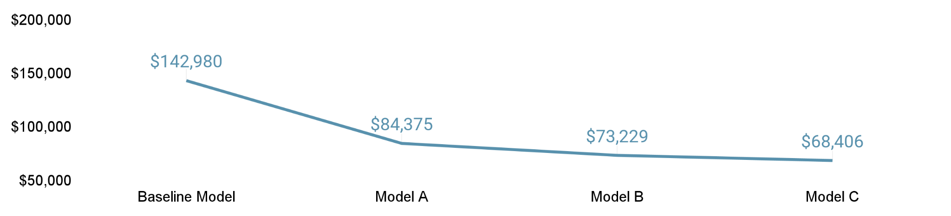
Our model is iteratively refined to provide the most accurate prediction for the average buyer
Baseline Model
Model A
Model B
Model C
Just take average resale price
Flat Model, Type, Size and Location
Floor Level, HDB Height and Age
Distance to Amenities
Error Size¹
% Error Size²
26%
14%
12%
11%
Note 1: Error size refers to the RMSE, a.k.a. average uncertainty in the resale price prediction (e.g., the error size of $20k means the predicted price could be on average $20k higher or lower than the actual price) on the test dataset
Note 2: % error size refers to the RMAPE, a.k.a. average percentage uncertainty in the resale price prediction on the test dataset
Notes:
To do this, we build up a predictive model
‘Up’ cos we build it iteratively adding variables and checking if each additional one improves the accuracy
And to determine if it is actually more accurate, we start off baseline
From naive perspective, average price
Error size is 146k. Explain error size and % error size
Our first model, model A, we add hdb flat’s inherent attributes
Instant improvement
Can we improve it further?
Yes, by adding HDB block level factors
Lastly, we talked about amenities, less slight improvement

Slide 14
The HDB flat’s inherent attributes and location have significant impact on resale price
Flat Size
Flat Model (v 2R Flexi)
Flat Type (v 1 Room)
Every 100sqft | $32k
Terrace | $414k
Mansionette | $49k~$143k
Type S1/S2 | $32k~$121k
DBSS | $108k
Multi-Gen | $73k
Apartment | -$43k~$68k
Simplified | -$21k
New Gen | -$31k
Improved | -$36k
Model A/A2 | -$84k~-$53k
Multi-Gen | $73k
Executive | $35k
5 Room | $35k
4 Room | $40k
3 Room | $28k
2 Room | $2k
Flat Location
(v outside central area)
Central | $84k
Notes:
Now that we have our model C, we can look at the impact of individual factors
We look at inherent atrributes of the flat
Before talking about the elephants on this slide, talk about flat size
This is the baseline you pay based on the size of the flat you wanna buy
Largest is flat model premium, pay up yo extra 411k for terrace
Then is flat type, pay extra 30k for a 5 room
Location is indeed impt, probably more impt than flat type if you are looking at central region, cos be prepared to fork out extra 85k compared to outside central region

Slide 15




Flat’s floor level and HDB block’s characteristics also have an impact on resale price but amenities have limited impact
Floor Level (v <Lvl 16)
HDB Block Height
HDB Age
>Lvl 30 | $75k
Lvl 16~30 | $44k
Every 10 lvls | $63k
Every 10 yrs older | -$23k
MRT Distance
Hawker Centre Distance
Mall Distance
Every 100m further | -$4.6k
Every 100m further | -$1.8k
Every 100m further | $1.1k
Notes:
And as conventional wisdom indicates, floor level also impt and impact can be quite big if you want higher floors. 76k premium compared to lower floors
HDB block attributes also matter, like how tall and old, albeit smaller extent
Against conventional wisdom, actually impact of amenities very small

Slide 16
In summary, a data-driven approach gives insights on most important factors affecting the price you can expect to pay
Flat Model
Up to
$414k
Flat Type
Up to
$73k
Flat Location
Up to
$84k
HDB Height
Up to
$63k
Floor Level
Up to
$75k
Floor Area
ea 100sqft
$32k
Notes:
These are the 6 you really should watch out for, and use to get a ballpark estimate of the expected price you need to pay

Slide 17
We are just scratching the surface…
Our analysis is suitable for the average buyer
But probably more useful than what you heard over WhatsApp
Notes:
We are scratching surface
Simplified the attributes to make it easier to digest for an intro ppt like this
More granular can be done, like to town level or the exact floor you thinking of. Can cut error size by ⅓

Slide 18
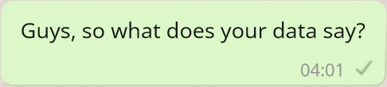
… are you an average buyer?
HDB attributes are valued differently by buyers based on their needs. We can further tailor the model based on buyer archetypes
Notes:
But the more impt qn is
Are you just an average buyer
Cos attributes are valued different based on buyer needs
And we can tailor our model to your needs
You have a family of 4, looking to have a place near central? We can segment the data and run a specific model for you, and that can further improve accuracy
The insights from data is rich
So next time, the property agents tell you grand theories, maybe the question of

Slide 19
THANK YOU
Q&A

